Slide 1

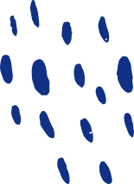




Bariatrics Measurement and Tracking System
SUPERVISED BY
MRS. S. RUKMANI DEVI
ASSISTANT PROFESSOR
DEPARTMENT OF CSE
PRESENTED BY
R HEAMANTH,
M MOHAMED MUSTAQ,
Ramkumaran S

Slide 2

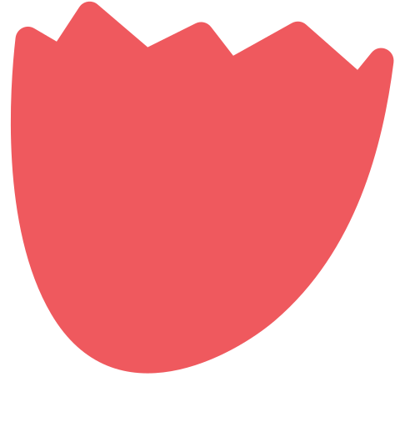

BMATS - This is a Web Application, As the name suggests, It's a tracking system that will allow the users to track their diet, food nutrients, BMI, and BMR. It also Provides Diet plans to maintain, Gain and Lose Weight based on the User's Basal metabolic rate. Diet Plans are suggested by Some of the world's Best Bariatricians.
Scope and
Objective

Slide 3



ABSTRACT
In the view of developing technology, changing lifestyles, and busy schedules, people often tend to neglect their health. This has led to an outcry about health-related issues among all age groups. The youngsters are the major victims of health problems as their uneven schedule makes it difficult to keep the track of the nutritional value of their meal intake and maintain daily health records manually. Since it is a well-known fact that what you eat while you are young is what you will be when you are old. The popularity and usage of Smartphone applications lead to the need for an application that can cater to the need for health management amongst youngsters. This paper presents the details of a fully functional Android Application for health management specifically targeting young people in India. The developed application solves the major practical problems faced during health management and meal intake

Slide 4

REACT JS
Front-Enfd/Client-Side
SQL-SERVER
TECH STACK
For Data Base
NODE JS & EXPRESS JS
For Server Side Application / Back-End-API
HEROKU AND NETLIFY
For Hosting Back-End & Front-End Respectively

Slide 5

SOFTWARE SPECIFICATION
React JS
React is a free and open-source front-end JavaScript library for building user interfaces based on UI components. It is maintained by Meta and a community of individual developers and companies.
Sass
Sass is a preprocessor scripting language that is interpreted or compiled into Cascading Style Sheets. SassScript is the scripting language itself. Sass consists of two syntaxes. The original syntax, called "the indented syntax," uses a syntax similar to Haml.
Axios
Axios is a promise-based HTTP Client for node. js and the browser. It is isomorphic (= it can run in the browser and nodejs with the same codebase). On the server-side it uses the native node. js http module, while on the client (browser) it uses XMLHttpRequests.

Slide 6
Passport JS
Passport is authentication middleware for Node.js. Extremely flexible and modular, Passport can be unobtrusively dropped in to any Express-based web application. A comprehensive set of strategies support authentication using a username and password, Facebook, Twitter, and more.
Node JS
Node.js is an open-source, cross-platform, back-end JavaScript runtime environment that runs on the V8 engine and executes JavaScript code outside a web browser.
Express JS
Express.js, or simply Express, is a back end web application framework for Node.js, released as free and open-source software under the MIT License. It is designed for building web applications and APIs. It has been called the de facto standard server framework for Node.js
SQL Server
Microsoft SQL Server is a relational database management system developed by Microsoft. As a database server, it is a software product with the primary function of storing and retrieving data as requested by other software applications—which may run either on the same computer or on another computer across a network.

Slide 7

SOFTWARE
REQUIREMENTS
Supported browsers:
Edge
Firefox
Chrome
Safari

Slide 8
EXISTING SYSTEM
HealthifyMe
HealthifyMe is an Indian digital health and wellness platform that provides services such as calorie tracking, one-on-one nutrition and fitness coaching, and diet and workout plans.
Healthy Buddy
HealthifyBuddy is also developed a bunch of college students for their final year project. it is also provided calorie tracking and diet tracking features.

Slide 9
PROPOSED SYSTEM
Unlike other Applications just focusing on a single feature, BMATS brings More Features in One Application. And it also brings the unique Feature of tracking Friends with which now users can check their Facebook friend's diets (if they have one) status .which will help them to stay motivated.

Slide 10
literature Survey
“All individuals need the same nutrients for the same body function. The only variation is in the amounts of each nutrient required according to age, size, and activity” as Proposed by S.R.Mudambi and M.V.Rajagopal
“Obesity and its management pose a tremendous economic burden on affected individuals and society, predominantly in the form of increased healthcare expenditures and lost productivity” - Jason Fung MD

Slide 11
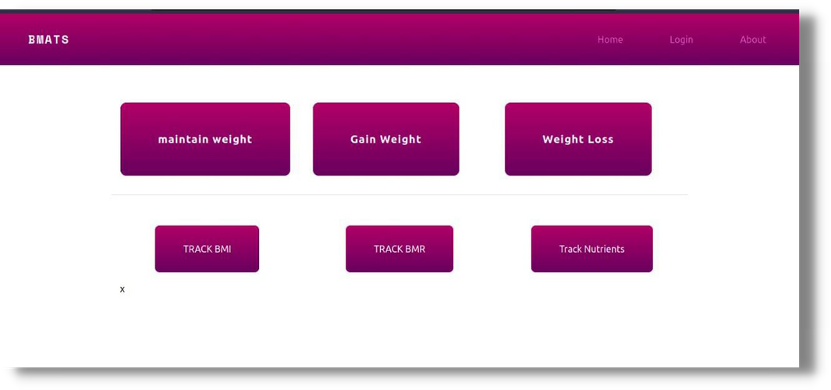
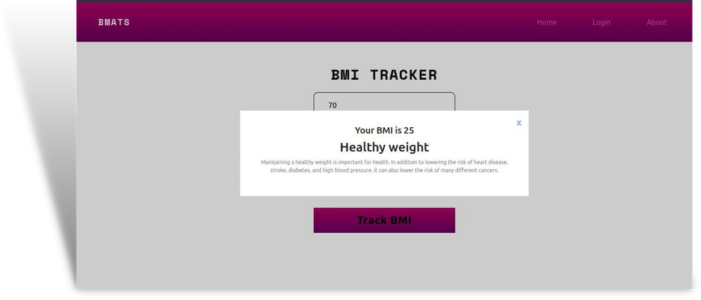
OUTPUT

Slide 12
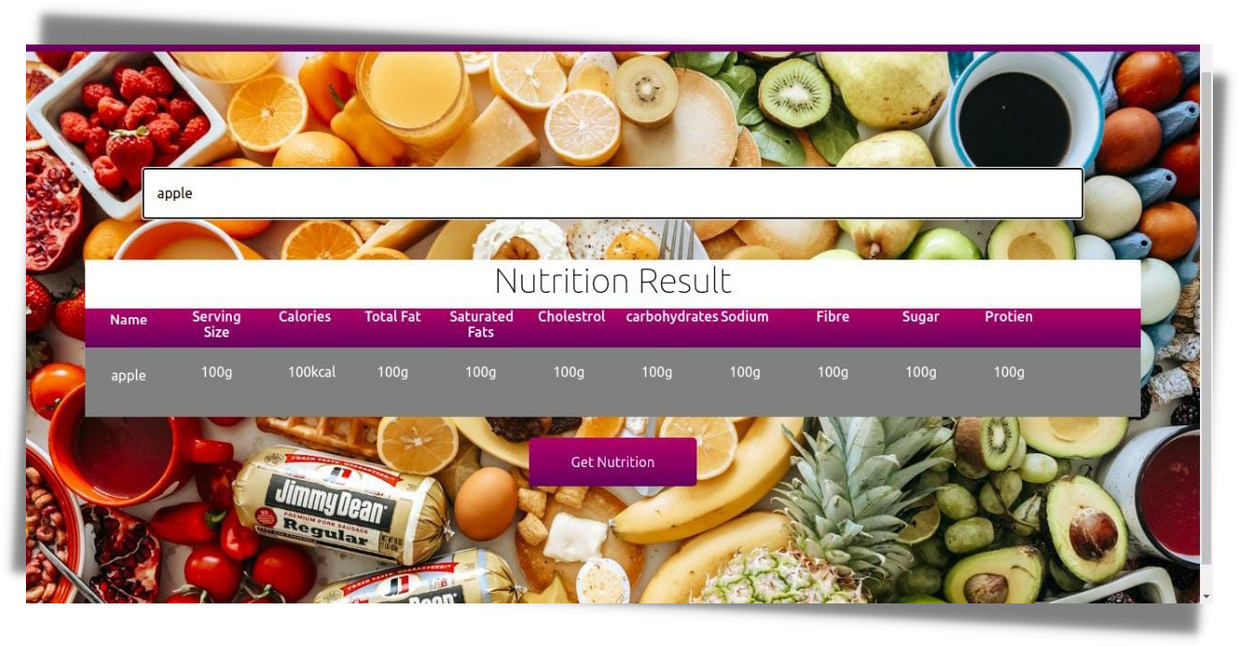

Slide 13
program
import React from 'react';
import BMIPopup from './BMIPopup';
// import { Link } from 'react-router-dom';
// import { useState } from 'react';
import {useState} from 'react'
function Bmitracker() {
const [trigger , setTrigger] = useState(false)
const [height,setHeight] = useState(0)
const [weight,setWeight] = useState(0);
function discription(){
if(bmiScore() > 25 )
return "according to a new study showing people who are even a little overweight face increased risk for many serious diseases, including diabetes, heart disease, colon cancer, high blood pressure, and gallstones."

Slide 14
else if (bmiScore() < 18)
return 'underweight may also be the reason for fatigue and lethargy as well as low blood pressure, heart rate and blood sugar levels, which can cause night sweats, having cold fingers and toes and muscle problems,'
else if (bmiScore() > 30)
return 'Being obese can also increase your risk of developing many potentially serious health conditions, including: type 2 diabetes. high blood pressure. high cholesterol and atherosclerosis (where fatty deposits narrow your arteries), which can lead to coronary heart disease and stroke.'
else
return'Maintaining a healthy weight is important for health. In addition to lowering the risk of heart disease, stroke, diabetes, and high blood pressure, it can also lower the risk of many different cancers.'
}

Slide 15
function bmiBariatrics(){
if(bmiScore() > 25 )
return 'overweight'
else if (bmiScore() < 18)
return 'underweight'
else if (bmiScore() > 30)
return 'obesity'
else
return'Healthy weight'
}
function bmiScore(){
if (height >= 15){
setHeight(height/10);
return (weight/height*height)
}

Slide 16
else{
return (Math.floor(weight/(height*height)))
}
}
function triggerPopup(){
console.log(bmiScore())
setTrigger(true)
}
return (
<div className="bmi">
<div className="bmi-form">
<label htmlFor="">BMI TRACKER</label>
<input className='side-border weight' type="number" onChange={(e)=>setWeight(e.target.value)} placeholder='Weight in KG' name='weight' />
<input className='side-border' type="number" onChange={(e)=>setHeight(e.target.value)} name="height" placeholder='height in cm' />

Slide 17
<input className='side-border' type="number" placeholder='Age' name='Age' />
<select name="gender" id="gender">
<option value="male">Male</option>
<option value="female">Female</option>
</select>
<BMIPopup trigger={trigger} bmi={bmiScore()} bariatrics={bmiBariatrics()} discription={discription()} />
<button id='bmiTracker' type='submit' onClick={triggerPopup} > Track BMI </button>
</div>
</div>
);
}
export default Bmitracker;

Slide 18
SASS Module : BMI Tracker
Coding:
@use 'variables' as v ;
input{
display: block;
padding:1rem 1rem ;
margin: auto;
// border-radius: 5px;
border: none ;
border-bottom:solid 1px black ;
}
select{
display: block;

Slide 19
padding: 1rem;
margin: auto;
width: 17.8rem;
border-color: black;
border-top:none ;
background: white;
border-bottom-left-radius: 10px;
border-bottom-right-radius: 10px;
}
input:after{
box-decoration-break:none ;
}
.bmi{
width: 100%;
place-items: center;
align-items: center;
text-align: center;

Slide 20
margin: 1rem 0;
}
.bmi-form{
margin: auto;
text-align: center;
align-items: center;
place-items: center;
}
.side-border{
border-left: solid 1px black;
border-right: solid 1px black;
}
.weight{
border-top:solid 1px black;
border-top-right-radius:10px;
border-top-left-radius:10px;
}

Slide 21
label{
color: black;
// background: v.$blueGradient;
font-family: v.$primeFont;
padding: 0 2rem;
font-size: 2rem;
font-weight: 600;
letter-spacing: 2px;
// margin: 2rem 0 ;
margin: 2rem 0px 1rem 0px ;
}
#bmiTracker{
padding: 10px 5rem;
margin: 2rem 0 ;
background: v.$blueGradient;
border: none;
font-size: 1.5rem;

Slide 22
font-weight: 600;
letter-spacing: 1px;
}
@media screen and (min-width: 1080px) {
input{
padding:1rem 2rem ;
}
select{
width: 19.5rem;
}
#bmiTracker{
padding: 10px 6rem;}
}
@media screen and (max-width: 480px) {
input{
padding:1rem 2rem ;

Slide 23
}
select{
width: 17.8rem;
}
#bmiTracker{
padding: 10px 5.2rem;}
}
React Module BMI Popup:
Coding:
import React from 'react';
// import { useState } from 'react';
function BMIPopup(props) {
// const [close ,setClose] = useState(false);
// const closed = props.trigger = false
return (props.trigger) ? (<div className='bmipopup'>

Slide 24
<div className="bmipopup-child">
{/* <FontAwesomeIcon icon="fa-solid fa-xmark" /> */}
<button className="close" ><a href="/bmi-tracker">x</a> </button>
<h5>Your BMI is <span> {props.bmi}</span> </h5>
<h3>{props.bariatrics}</h3>
<p>{props.discription}</p>
</div>
</div>):''
;
}
export default BMIPopup;

Slide 25


CONCLUSION & FUTURE ENCHANCEMENTS
15
The above-proposed method is used to enhance the understanding of food nutrition and to improve the user's diet and it will provide the user with a better outlook to achieve their fitness goals by exactly showing them the idea behind the relationship between food intake and weight goals.
In this paper, we have presented BMI, BMR, and Nutrition trackers only, in the future we would like to finish the application by expanding the application with a proper personalized tracking system for individual users with personalized diet plans and also allowing the user to login to their Facebook accounts and also we are planning to come up with a unique feature which allows the users to connect with their Facebook friends and track their accomplishments.

Slide 26
Thank You Everyone!
Eat Healthy, Stay Healthy

